Slide 1


Studying for Durable (Effective) Learning
Engineering Peer Helpers
Notes:
Hi everyone and welcome to this workshop, hosted by the Engineering Peer Helpers. Today we will be covering studying for durable learning.

Slide 2
Agenda
What is Durable Learning?
Benefits of Durable Learning
Common Studying Mistakes
Methods to Incorporate Durable Learning
Notes:
We will start by discussing what durable learning is and what some of the benefits are. We will then be discussing some common studying mistakes and finally some techniques you can use to optimize your studying.

Slide 3
What is durable learning?
Thorough Understanding
Long-Term Memory
Notes:
Durable learning can be broken down into 2 main ideas. Firstly, it’s learning with the intention of obtaining a deep understanding of the material. This means trying to understand the significance of the concepts being taught, how the different concepts relate to each other and various applications in which this material could be useful. Secondly, durable learning involves studying with the intention of transferring what you have learned to your long-term memory rather than cramming with the intention of just getting through the exam.

Slide 4
Benefits of durable learning
Leads to better academic grades
Reduces stress associated with cramming
Makes studying more efficient
Allows you to prepare for multiple exams
Notes:
We will now discuss some of the major benefits. Firstly, durable learning will lead to better academic grades. There has been multiple studies, referenced in a book at the end of this presentation, showing that students who use optimal study techniques often perform better in exams and these popular study techniques actually contribute to durable learning. It also reduces stress since durable learning is learning that occurs over a long period and thus since you will be studying in advance of the deadline you won’t be cramming. Durable learning also makes studying more efficient because using optimal study techniques allows you to get more done in a shorter period. Additionally, it allows you to study for multiple exams at once since you are not worried that focusing on another course will make you forget this material and prepares you for weeks when you have multiple exams.

Slide 5
Common studying mistakes
Illusions of Knowing
Passive Learning
Not Testing Themselves Enough
Notes:
There has been research showing that the study techniques that are most often used by students are often the least effective and we will touch on some of them here. Firstly, it’s the illusion of knowing. The illusion of knowing is thinking you understand the material but in reality you don’t. An example of this would be trying a practice problem, getting stuck and then looking at the solution and saying oh yea that makes sense and feeling like you’re now prepared for the exam, when in reality if you were faced with a slightly different problem you wouldn’t actually know how to solve it. A second common mistake is focusing on passive learning. Passive learning is learning that does not take a lot of effort and is simply sitting back and trying to absorb the material. This would include spending most of your studying time reading the solutions or re watching a lecture or reading through the textbook. It’s shown that active learning is actually more effective and we will talk about this in the next slide. Lastly, a big studying mistake is students not testing themselves enough. It’s been shown that learning doesn’t occur when information is going into your brain but the real learning actually occurs when you try to retrieve the information from your brain. A likely reason for why you may have not performed well on an exam is that you simply didn’t test yourself enough.

Slide 6

Optimal study techniques
Active Recall
Space Repetition
Interleaving Concepts
Test Yourself
Ask Questions
Notes:
We will now go over how to utilize durable learning in your studying. Firstly, you should focus on active recall. This simply means trying to retrieve information from your brain. For memorization-based courses this would involve asking yourself questions and without looking at your notes trying to answer the question. For problem solving based courses this would mean trying to solve a problem without looking at the solutions and only using material you would be allowed on the exam.
Secondly, you should incorporate spaced repetition which is the opposite of cramming. This would mean testing yourself with practice problems throughout the course and this is beneficial because the more often we test ourselves the longer it takes for us to forget the information and this will reduce the amount of time you will actually have to spend cramming the night before an exam.
Thirdly, interleaving concepts is shown to increase better memory and performance. This mean attempting problems from different chapters at the same time and studying for multiple courses throughout the same day or time period. This is beneficial because while it’ll make it harder when you’re studying, you’ll be more prepared when writing the exam because you will be better able to distinguish which chapter each problem is from.
As mentioned before if you weren’t happy with your performance on an exam it’s likely that you didn’t test yourself enough. The best way to study is to continually test yourself with practice problems, not just before the exam but throughout the course and testing yourself in an exam setting. A lot of students think that this is wasting time to spend 10 minutes on a problem just to look at the solution once you’re done to realize you were completely wrong. But in reality this is where real learning occurs because you are figuring out what you don’t understand and you are replicating an exam scenario. Even if you are not comfortable with the material you should still attempt the practice problem. An example of this would be in lectures when professors give you time to work on a problem, you should actually sit down and try to struggle and work through it. Even though you might not get the right answer you will probably get some steps right but more importantly you will identify early on what you don’t understand which will make allow you to figure out why you don’t understand it. It’s been shown that the harder the studying is, the more beneficial it is.
Lastly, you should ask yourself questions while studying. If you are doing a problem and don’t understand what to do next, you should figure out what you don’t understand and why you don’t understand it and write it down somewhere. If your studying consistently you will have a bank of these questions that identify the gaps in your knowledge. You should consistently try to answer these questions by going back to the material, asking your professor or TA for help or seeking external resources because it is likely these will be the same areas where you will get stuck on the exam.

Slide 7
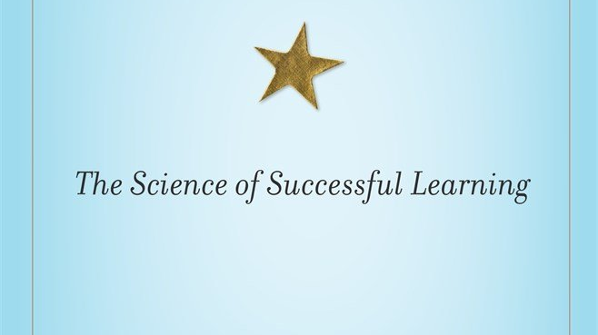
Make it Stick
Notes:
Lastly, if you are interested on the concept of improving your study strategies or wanted more information on anything touched on in this presentation, or any of the studies or references that were mentioned, I would highly recommended reading this book called Make it Stick or even searching up a summary. Using the techniques mentioned in this book is very likely to improve your academic performance and also make your studying more efficient so you have more time to spend on other things.

Slide 8





Website
uoguelph.ca/engpeers
E-mail engpeers@uoguelph.ca
Facebook
Find us at @engpeers!
Instagram
Find us at @engpeers_uog
Notes:
Hopefully you enjoyed the presentation and learned something new! If you have any questions or concerns about anything that you would like to talk with an upper year engineering student about you can book an appointment with us through out website! Here are all of our contact information in which we post regular updates and content we’re producing so make sure to follow us!

Slide 9
Credits
Produced by: David Sebben

